Slide 1
CellClick() Clicked on a cell
If the game is on
NO
Do I have something selected?
Select this cell & show it’s moves
Clicked on friendly cell
If it is my piece
YES
What cell was clicked?
Select this cell & show it’s moves
Clicked on empty cell
If unit reached the end
Move the piece
NO
YES
Do Nothing
Is the cell valid move?
Didn’t eat
Did I eat a unit?
Ate a unit
Change player & End turn
Can I eat another?
Change player & End turn
NO
YES
Continue the combo
Did I Win?

Slide 2
getAllMoves( )
Called possible moves and to check If a unit can eat
legalMoves = [ ]
direction white= 1 / black = -1
Normal piece
What type was clicked?
Queen piece
Add eat forward
Add eat all directions any distance
If I just ate add eat backwards
Can Any of my units eat an enemy?
YES
Can Any of my units eat an enemy?
YES
NO
NO
Add move forward
Add move all directions any distance
Mark cells
Mark cells
return legalMoves
return legalMoves

Slide 3
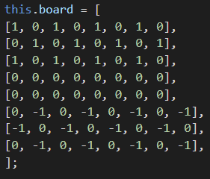
Object data of class BoardData()
data
Board
row[0]
row[…]
row[7]
currentPlayer
Combo
canEat
endGame
Did I just eat an enemy?
Can any of my units eat an enemy?
Did a player win?

